Slide 1

Causal Testing:
Understanding defects root causes
Dr. Brittany Johnson-Matthews
Assistant Professor in Computer Science
George Mason University
CAHMP Core Faculty
https://brittjay.me
https://cahmp.gmu.edu/

Slide 2
Today’s Talk
How did we get here (and by we, I mean me)?
Improving what you already do with what already exists
Where else can this apply?
Is it really useful?
Notes:
better transition -- be explicit about ethics throughout
Explain tests, debugging for transition

Slide 3
Prior work Causal Testing There’s more! Evaluation
What’s the back story on the research
In today’s presentation
Notes:
At the root of this difficulty and frustration is the developer attempting to answer…

Slide 4
Prior work Causal Testing There’s more! Evaluation
It all started with a study…
Study of why developer do and don’t use tools
Findings suggest the major issues include:
tool output
result understandability
tool design
workflow integration
So I went on a mission to provide useful, usable, and validated interventions
for improving software practice.
Notes:
better transition -- be explicit about ethics throughout
Explain tests, debugging for transition

Slide 5
Prior work Causal Testing There’s more! Evaluation
Fast forward to post-phD…
Opportunity to work in the testing space – cool!
We already know testing is powerful (and commonly used).
But as I made progress, I realized:
There are a lot of techniques available for use.
Traditional testing alone does not answer the question ”why is this happening?”
Notes:
better transition -- be explicit about ethics throughout
Explain tests, debugging for transition

Slide 6
Prior work Causal Testing There’s more! Evaluation
Can we take what developers already do,
and the work that’s already been done,
to provide insights that existing tools don’t
Notes:
At the root of this difficulty and frustration is the developer attempting to answer…

Slide 7
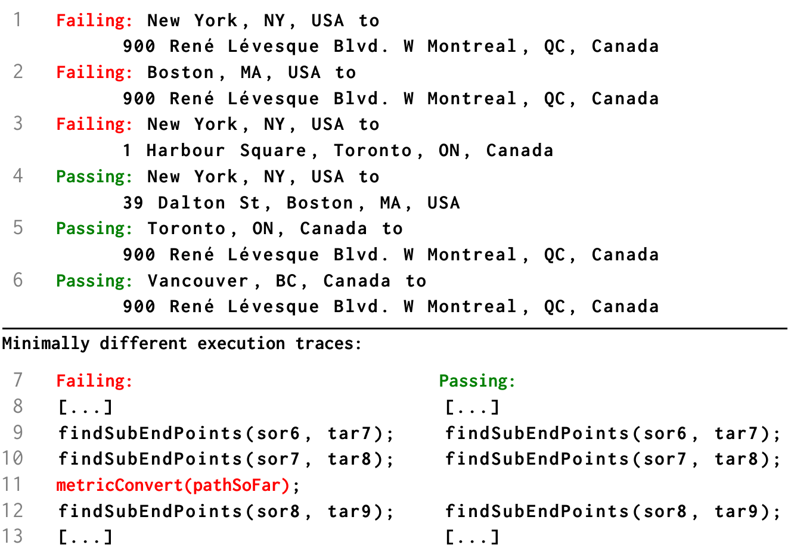
Prior work Causal Testing There’s more! Evaluation
Causal Testing
Automated causal experiments
Start with existing test cases
Uses existing debugging techniques
Goal = minimally different executions
Notes:
better transition -- be explicit about ethics throughout
Explain tests, debugging for transition

Slide 8
Prior work Causal Testing There’s more! Evaluation
Causal Testing
Bug report
Directions from
New York, NY, USA
to
900 René Lévesque Blvd.
W. Montreal, QC, Canada
are wrong.
Failed test:
assertTrue(pathFromTo(“New York, NY, USA”, “900 René Lévesque Blvd. W. Montreal, QC, Canada”));
Perturb input(s) & execute tests:
Pass
Fail
pathFromTo(“New York, NY, USA”, “W. Montreal, QC, Canada”)
pathFromTo(“New York, NY, USA”, “René Lévesque Blvd. W. Montreal, QC, Canada”)
pathFromTo(“New York, NY, USA”, “1 Harbor Point Blvd. Boston, MA, USA”)
pathFromTo(“Boston, MA, USA”, “900 René Lévesque Blvd. W. Montreal, QC, Canada”)
pathFromTo(“Vancouver, BC, Canada”, “900 René Lévesque Blvd. W. Montreal, QC, Canada”)
...
Find most similar
input + execution
Similar passing:
pathFromTo(“New York, NY, USA”, “1 Harbor Point Blvd. Boston, MA, USA”)
pathFromTo(“Vancouver, BC, Canada”, “900 René Lévesque Blvd. W. Montreal, QC, Canada”)
Similar failing:
pathFromTo(“New York, NY, USA”, “René Lévesque Blvd. W. Montreal, QC, Canada”)
pathFromTo(“Boston, MA, USA”, “900 René Lévesque Blvd. W. Montreal, QC, Canada”)
Notes:
better transition -- be explicit about ethics throughout
Explain tests, debugging for transition

Slide 9
Prior work Causal Testing There’s more! Evaluation
What else can we do with
Causal Testing
Notes:
At the root of this difficulty and frustration is the developer attempting to answer…

Slide 10





Prior work Causal Testing There’s more! Evaluation
Causal Fairness Testing
LOAN
software
LOAN
software
LOAN
software
LOAN
software
income
savings
age
race
…
How often is the outcome different because of race alone?
http://fairness.cs.umass.edu
Notes:
Explain tests, debugging for transition

Slide 11

Prior work Causal Testing There’s more! Evaluation
ML-Based causal Testing
trained ML model
April
red
12345
PhD
John
green
01020
PhD
Software
X
assertEqual ( )
name
race
zip code
degree
April
red
12345
PhD
assertTrue ( , )
Notes:
better transition -- be explicit about ethics throughout
Explain tests, debugging for transition

Slide 12
Prior work Causal Testing There’s more! Evaluation
Is it useful
Notes:
At the root of this difficulty and frustration is the developer attempting to answer…

Slide 13
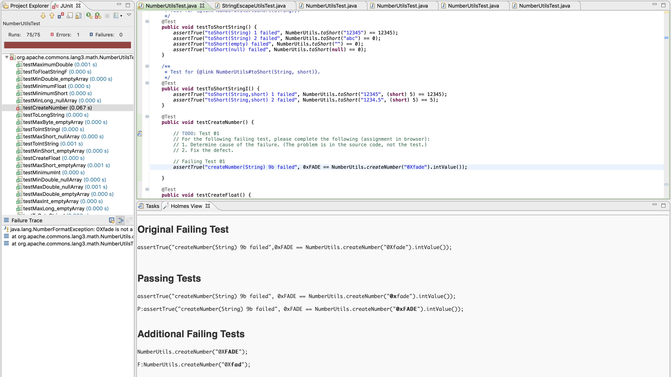
Prior work Causal Testing There’s more! Evaluation
Holmes
proof-of-concept Causal Testing implementation
http://holmes.cs.umass.edu/
Notes:
better transition -- be explicit about ethics throughout
Explain tests, debugging for transition

Slide 14
Prior work Causal Testing There’s more! Evaluation
Can causal testing help developers debug
Does Causal Testing improve ability to identify defect root cause?
Does Causal Testing improve ability to repair defects?
Do developers find Causal Testing useful?
What’s most useful?
YES!
YES!
YES!
Similar passing tests → cause identification
Notes:
better transition -- be explicit about ethics throughout
Explain tests, debugging for transition

Slide 15
Causal Testing is a useful technique that provides more insight into faulty executions with code you’ve already written.
Notes:
At the root of this difficulty and frustration is the developer attempting to answer…

Slide 16
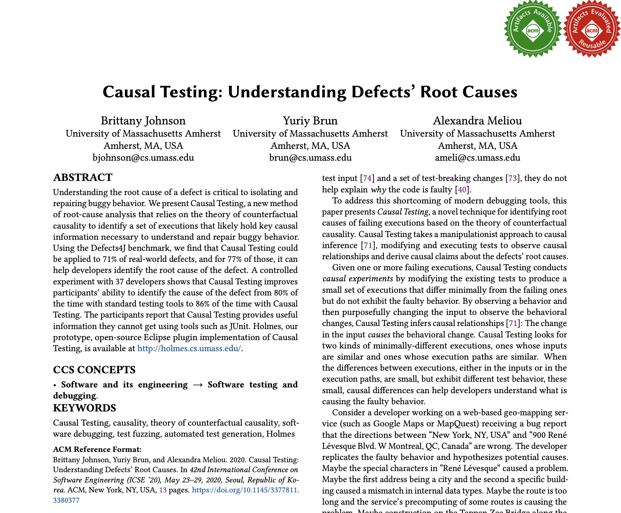
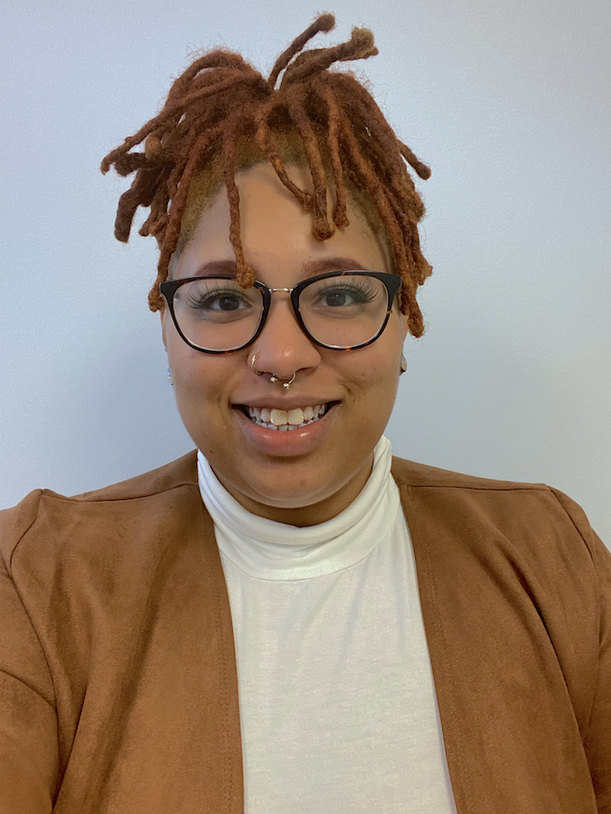
Thanks!
Brittany Johnson
johnsonb@gmu.edu
Notes:
the idea of..
Its unclear if and how fair aware affect performance
Best config data specific
Tuning can be effective but time consuming (and helps if you know what to tune and why)

Slide 17

Prior work Causal Testing There’s more! Evaluation
My research
Understanding
Software Practices
Developing
Equitable Software
ML-based software fairness
can we test/analyze software for fairness
Developer Tool Use
when, why, and how we use tools
https://fairness.cs.umass.edu
Work Environments
how does environment affect work
can we support model fairness evaluation
http://go.gmu.edu/fairkit-learn
Engaging the Margins
how do we responsibly engage /amplify marginalized groups in research and development
Improving
Software Practices
Debugging
how can we support debugging
Software for social impact
Technology for the Black Experience
how can and should tech support Black lives
http://go.gmu.edu/Tech4BlackLives
Tool Adoption
how can we improve adoption
Tool Communication
how can we improve communication
Equitable Healthcare
how can we use data to improve healthcare equity
Notes:
maybe don't say fairness so soon

